Slide 1


Sabari Mana
11-June-2023

Slide 2

Outline
Executive Summary
Introduction
Methodology
Results
Conclusion
Appendix

Slide 3
Executive Summary
Summary of methodologies
Data Collection through SpaceX REST API
Data Collection with Web Scraping
Data Wrangling
Exploratory Data Analysis with SQL
Exploratory Data Analysis with Data Visualization
Interactive Visual Analytics with Folium
Machine Learning Prediction
Summary of all results
Result of exploratory Data Analysis
Result of Interactive analytics
Result of Predictive Analytics

Slide 4
Introduction
Project background and context
Space X advertises Falcon 9 rocket launches on its website with a cost of 62 million dollars; other providers cost upward of 165 million dollars each, much of the savings is because Space X can reuse the first stage. Therefore, if we can determine if the first stage will land, we can determine the cost of a launch. This information can be used if another player wants to bid against space X for a rocket launch. This goal of the project is to create a machine learning pipeline to predict if the first stage will land successfully.
Problems you want to find answers
What are the factors that determine if the rocket will land successfully?
How the various features interact together to determine the success rate?
The different operating conditions that ensure a successful landing?

Slide 5

Section 1

Slide 6
Methodology
Executive Summary
Data collection methodology:
Data Collection is done using the SpaceX REST API and Web Scraping from Wikipedia
Perform data wrangling
For categorical features, OneHotEncoder from sklearn is used for data wrangling
Perform exploratory data analysis (EDA) using visualization and SQL
Perform interactive visual analytics using Folium and Plotly Dash
Perform predictive analysis using classification models
How to build, tune, evaluate classification models

Slide 7
Data Collection
Describe how data sets were collected.
Using the SpaceX REST API data is collected.
In the next step, the REST response is converted to json format and then to a Pandas Dataframe.
Next to clean the data, checked for missing or null values and then filled with appropriate data, like mean
During Data Wrangling of the Wikipedia data, used the library BeautifulSoup for web scraping.
The intent was to extract the Falcon 9 launch records as HTML table, parse the table and convert it to a pandas Dataframe for data analysis.

Slide 8
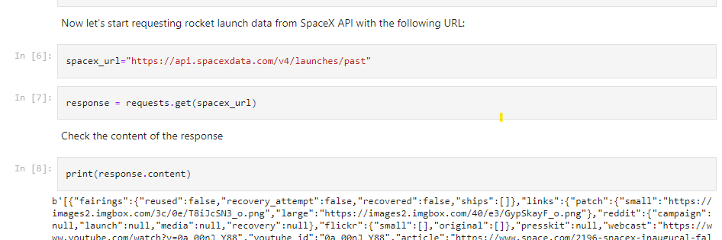
Data Collection – SpaceX API
Used the GET request to the SpaceX REST API to collect data. In the next step, cleaned this data and performed data wrangling.
The link to the Jupyter notebook: https://github.com/sabarium/ibm_ds_capstone/blob/main/jupyter-labs-spacex-data-collection-api.ipynb

Slide 9
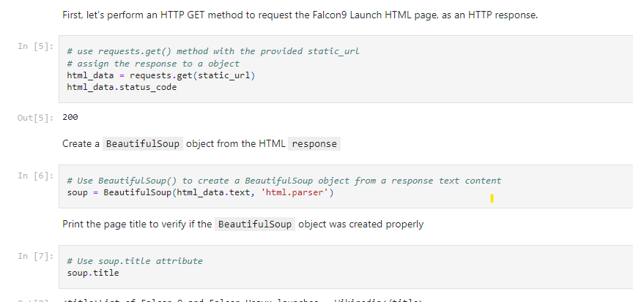
Data Collection - Scraping
Performed web scrapping to on Falcon 9 launch records in the Wikipedia html tables using the library BeautifulSoup
Next converted the scraped tables into pandas Dataframe.
The link to the notebook is https://github.com/sabarium/ibm_ds_capstone/blob/main/jupyter-labs-webscraping.ipynb.

Slide 10
Data Wrangling
As part of Data Wrangling, exploratory data analysis is performed and determined the training labels.
Extracted the number of launches at each site and the number and occurrence of each orbits
Formed the landing outcome label from outcome column
The Jupyter notebook of the Data Wrangling stage is this: https://github.com/sabarium/ibm_ds_capstone/blob/main/labs-jupyter-spacex-data_wrangling_jupyterlite.jupyterlite.ipynb.

Slide 11

EDA with Data Visualization
In the next step, explored the data by visualizing the relationship between various features.
Flight number and launch Site
Payload and launch site
Flight Number and Orbit Type
Success rate of each orbit type
The launch success yearly trend.
It becomes obvious that the success rate has been improving over the years.
Notebook link: https://github.com/sabarium/ibm_ds_capstone/blob/main/jupyter-labs-eda-dataviz.ipynb.jupyterlite.ipynb

Slide 12
EDA with SQL
Loaded the SpaceX dataset into an SQLite database
Performed Exploratory Data Analysis with SQL to get insight from the data. Some of the queries included:
The names of unique launch sites in the space mission.
The total payload mass carried by boosters launched by NASA (CRS)
The average payload mass carried by booster version F9 v1.1
The total number of successful and failure mission outcomes
The failed landing outcomes in drone ship, their booster version and launch site names.
The Jupyter notebook for EDA with SQL is available here: https://github.com/sabarium/ibm_ds_capstone/blob/main/jupyter-labs-eda-sql-coursera_sqllite%20(1).ipynb

Slide 13
Build an Interactive Map with Folium
Used the Folium library to represent the co-ordinates of the Launch Sites in a map
Marked all launch sites on a map
Marked the success/failed launches for each site on the map
Calculated the distances between a launch site to its proximities
Used folium.Circle to add a highlighted circle area with a text label on a specific coordinate. Similarly, used other folium map objects like markers and lines lines to mark the success or failure of launches for each site on the folium map.
Assigned the feature launch outcomes to class 0 and 1 where 0 represents failure and 1 represents success.
Used marker clusters to identify the launch sites with high success rates.
Jupyter Notebook with Interactive Folium Map:
https://github.com/sabarium/ibm_ds_capstone/blob/main/lab_jupyter_launch_site_location.ipynb

Slide 14
Build a Dashboard with Plotly Dash
Using Plotly dash a program for an interactive dashboard is created
The total launches at each site is represented with a pie chart
Also plotted a scatter graph showing the relationship with Outcome and Payload Mass (Kg) for different booster versions.
The python program for the dashboard is available here: https://github.com/sabarium/ibm_ds_capstone/blob/main/dash_app.py

Slide 15
Predictive Analysis (Classification)
In the next step, using numpy and pandas libraries loaded the data to a Dataframe, transformed it and split the data into training and testing using sklearn train_test_split.
Created different machine learning models and tuned the hyperparameters using GridSearchCV.
Used the accuracy metric for identifying the best model
The model with the best accuracy is the classification model.
The Jupyter notebook is: https://github.com/sabarium/ibm_ds_capstone/blob/main/SpaceX_Machine_Learning_Prediction_Part_5.jupyterlite.ipynb

Slide 16
Results
Exploratory data analysis results
Interactive analytics demo in screenshots
Predictive analysis results

Slide 17

Section 2

Slide 18

Flight Number vs. Launch Site
The scatter plot of FlightNumber vs. Launch Site
The blue dots show the failed landings. Site CCAFS LC-40 has maximum launches

Slide 19
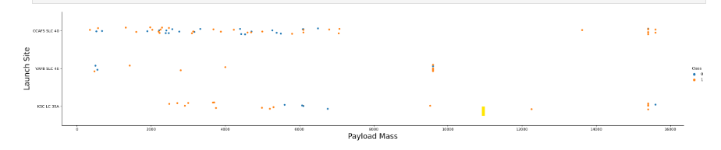
Payload vs. Launch Site
Scatter plot of Payload vs. Launch Site
Launch site CCAFS LC-40 has higher success rate with higher Payload mass

Slide 20

Success Rate vs. Orbit Type
Bar chart for the success rate of each orbit type
ES-L1, GEO, HEO, SSO, VLEO had the most success rate.

Slide 21

Flight Number vs. Orbit Type
Scatter point of Flight number vs. Orbit type
For the LEO orbit, success is related to the number of flights whereas in the GTO orbit, there is no relationship between flight number and the orbit.

Slide 22

Payload vs. Orbit Type
Show a scatter point of payload vs. orbit type
For heavier payloads, the number of successful landings is more for PO, LEO and ISS orbits.

Slide 23
Launch Success Yearly Trend
Line chart of yearly average success rate
The success rate since 2013 kept on increasing till 2020.

Slide 24
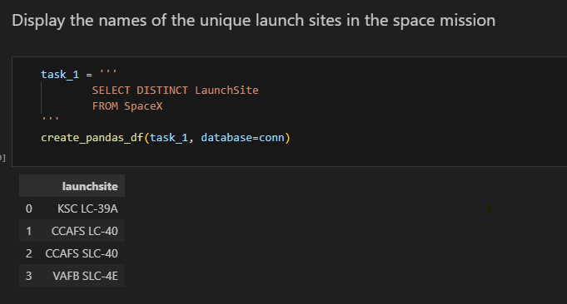
All Launch Site Names
The names of the unique launch sites
Using the ‘distinct’ keyword, the SQL returns the unique Launch Sites

Slide 25
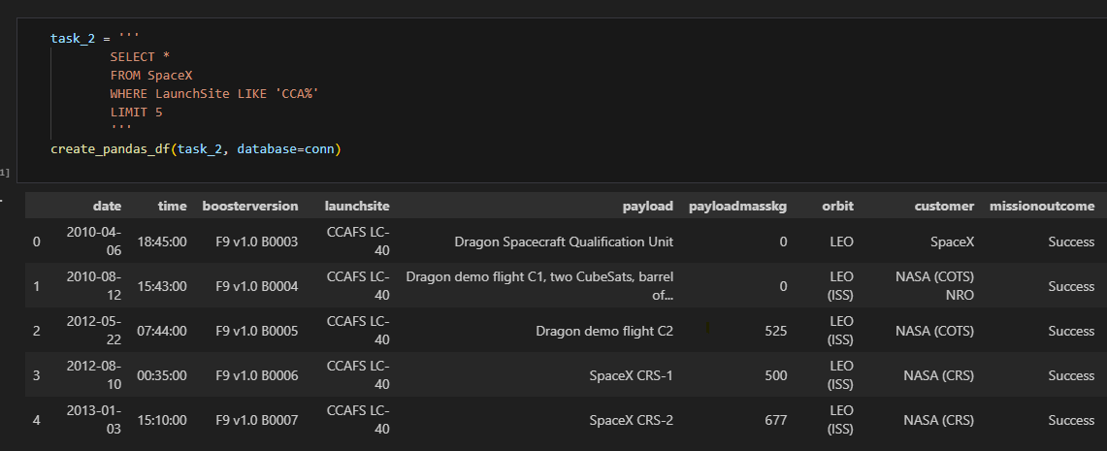
Launch Site Names Begin with 'CCA'
Find 5 records where launch sites begin with `CCA
Using the ‘Like’ identify the sites with the pattern and ‘limit’ the results to 5

Slide 26
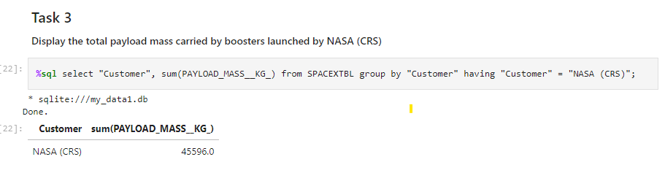
Total Payload Mass
Calculate the total payload carried by boosters from NASA
Used the ‘Group By’ and ‘having’ clauses to calculate the total payload

Slide 27
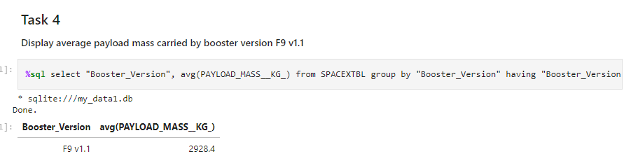
Average Payload Mass by F9 v1.1
Calculate the average payload mass carried by booster version F9 v1.1

Slide 28
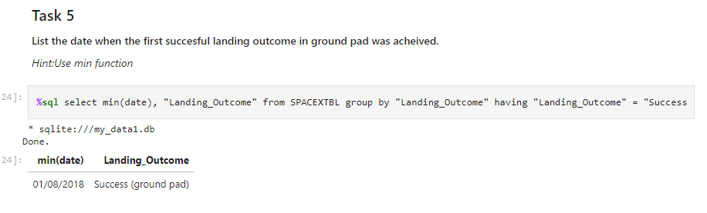
First Successful Ground Landing Date
Find the dates of the first successful landing outcome on ground pad

Slide 29
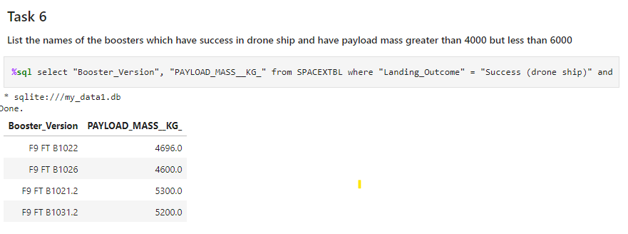
Successful Drone Ship Landing with Payload between 4000 and 6000
List the names of boosters which have successfully landed on drone ship and had payload mass greater than 4000 but less than 6000

Slide 30
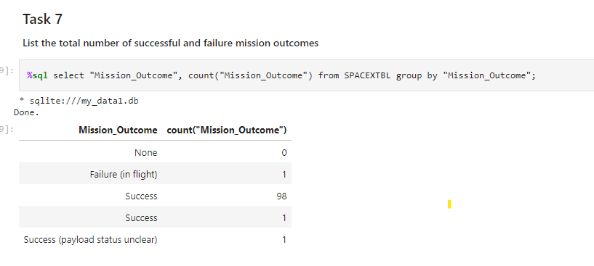
Total Number of Successful and Failure Mission Outcomes
Calculate the total number of successful and failure mission outcomes

Slide 31
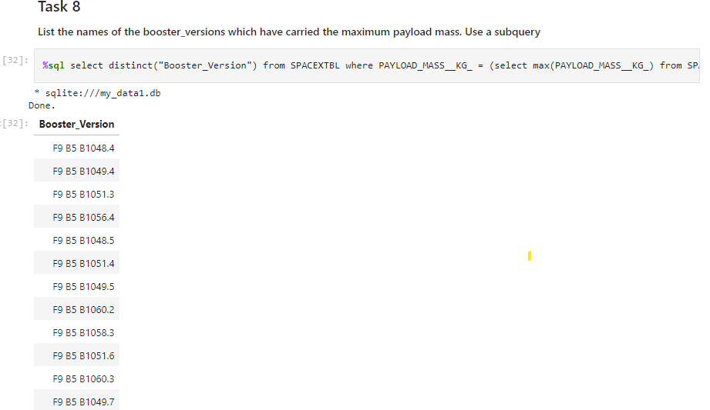
Boosters Carried Maximum Payload
List the names of the booster which have carried the maximum payload mass

Slide 32
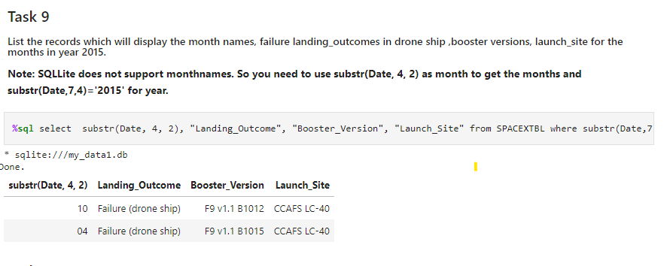
2015 Launch Records
List the failed landing_outcomes in drone ship, their booster versions, and launch site names for in year 2015

Slide 33
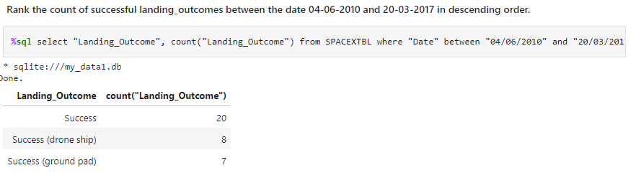
Rank Landing Outcomes Between 2010-06-04 and 2017-03-20
Rank the count of landing outcomes (such as Failure (drone ship) or Success (ground pad)) between the date 2010-06-04 and 2017-03-20, in descending order
Present your query result with a short explanation here

Slide 34

Section 3

Slide 35

SpaceX Launch Sites Map

Slide 36

Markers showing launch sites

Slide 37

Proximities with distance from Launch Sites

Slide 38

Section 4

Slide 39
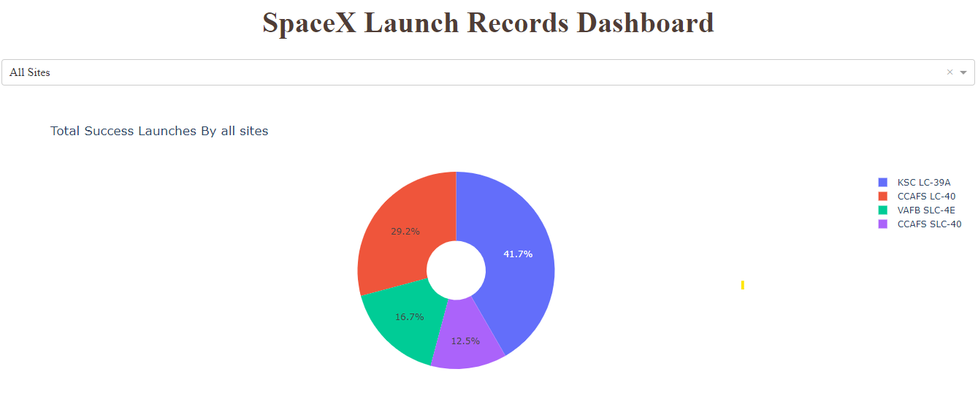
Success Rate per Launch Site

Slide 40

Launch Site with highest Success Rate

Slide 41
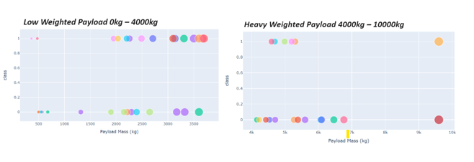
Payload vs Outcome

Slide 42

Section 5

Slide 43
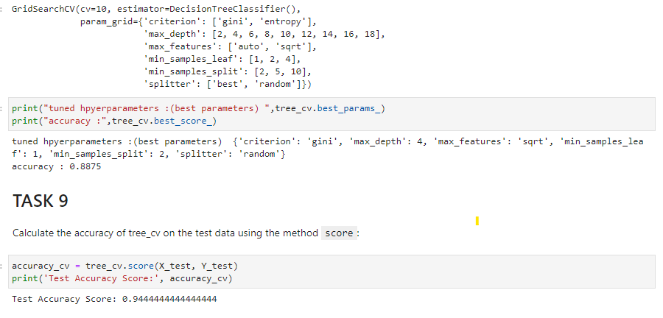
Classification Accuracy

Slide 44

Confusion Matrix
The confusion matrix for the decision tree classifier
It shows that the classifier can distinguish between the different classes.
One problem with this model is the false positives which means unsuccessful landings are marked as successful landing by the classifier.

Slide 45
Conclusions
Some of the major findings from using the machine learning models for the SpaceX launches:
Heavier payloads result in better success at launch sites
Orbits ES-L1, GEO, HEO, SSO, VLEO had the most success rate.
KSC LC-39A had the most successful launches of any sites.
A classification model using Decision Tree shows best accuracy in predicting the launch result
Launch success rate steadily increases over the years

Slide 46


